Slide 1

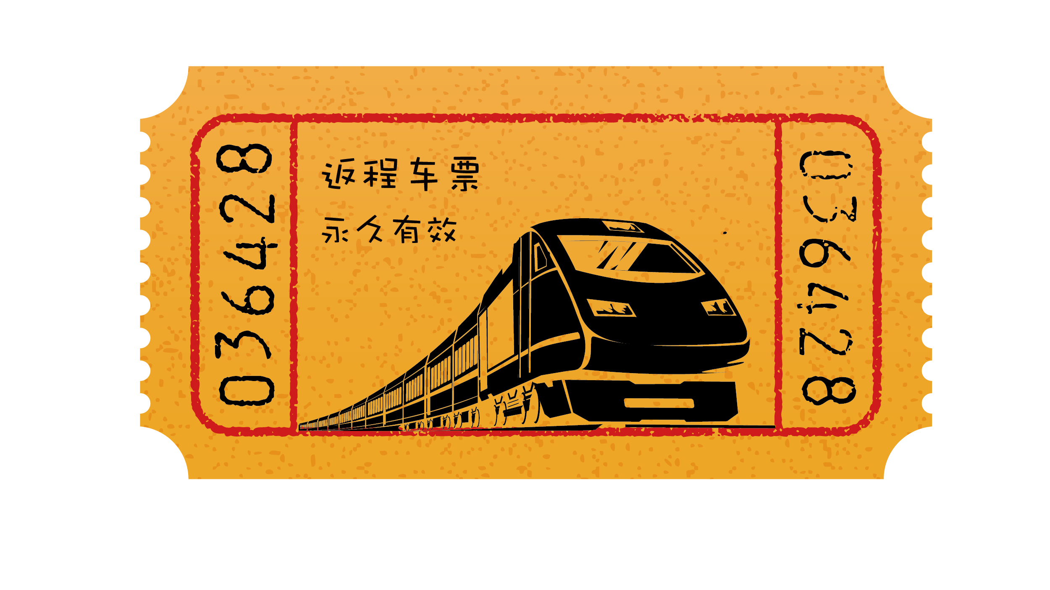
TRAIN TICKET PRICE PREDICTION

Slide 2




TEAM 8
Lalitha Sravani Gannavarapu
Team Lead
Bhavana Yelisetti
Data Scientist
Apurva Ravikar
Storytelling and Data Visualization
Kavita Madiraju
Data Collection and Preprocessing

Slide 3

INTRODUCTION
In today's ever-changing transportation landscape, accurately predicting train ticket prices is vital for providing efficient and cost-effective travel solutions. The complexity of factors such as demand and varied routes poses challenges for traditional pricing models. A successful prediction model ensures fair pricing for passengers, allowing railway companies to optimize revenue and enhance overall service quality.

Slide 4

Challenge
How to predict the price of Train ticket based on certain features?
Train ticket prices are influenced by a multitude of factors, making them a complex and dynamic pricing challenge. However, with the power of data and machine learning, we aim to create models that provide accurate fare predictions. Challenges in this endeavor include handling the variability in demand, accounting for different travel classes and routes, and adapting to changing market dynamics. As the industry evolves, these models can play a pivotal role in optimizing pricing strategies for the benefit of both consumers and railways

Slide 5

Solution
Data science and machine learning have a wide range of applications across various domains and industries. These technologies have the potential to extract valuable insights, make predictions, and automate tasks, leading to improved decision-making and efficiency. Predicting train ticket fares is a complex task that involves multiple variables and factors. Data Science and Machine learning techniques can be used to build an effective solution for predicting train ticket fares.

Slide 6
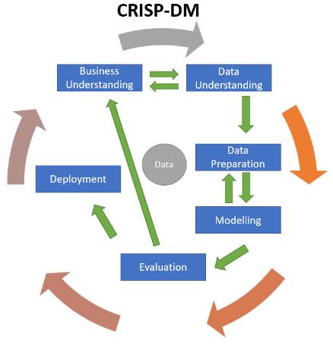
USER STORY
User Story
As a User, I should be able to book a train ticket that meets all my requirements
Sub Goal
take in the specifications of the customer and process them to find the solution that meets all or maximum of the specifications
Business Goal
Main Goal
To suggest a train ticket to the customer
Product

Slide 7
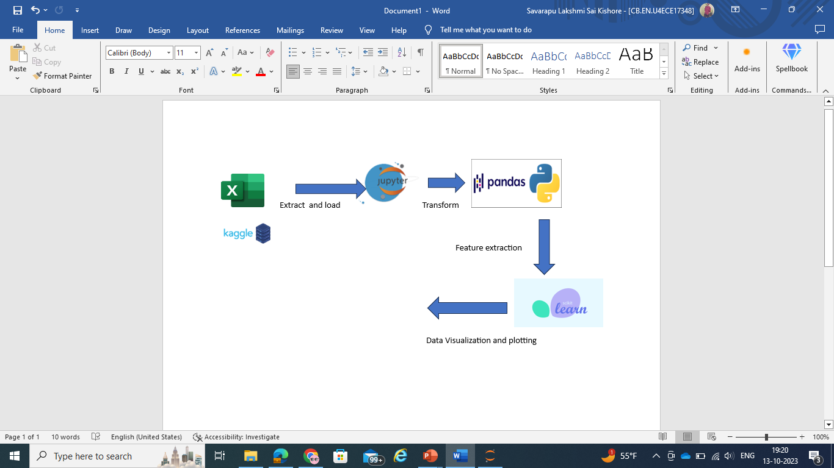
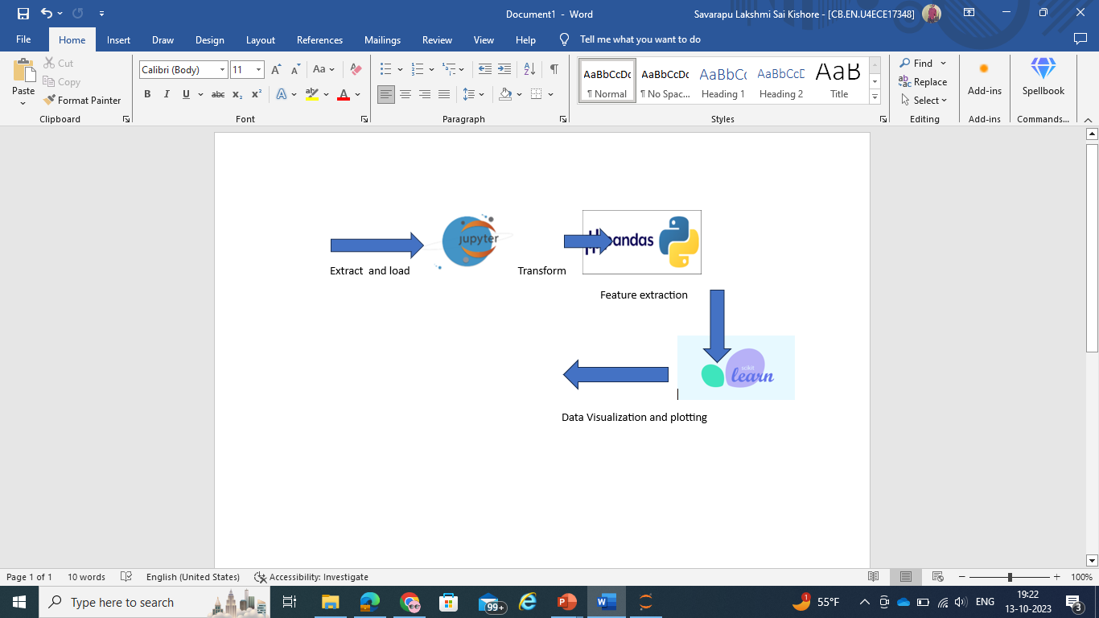
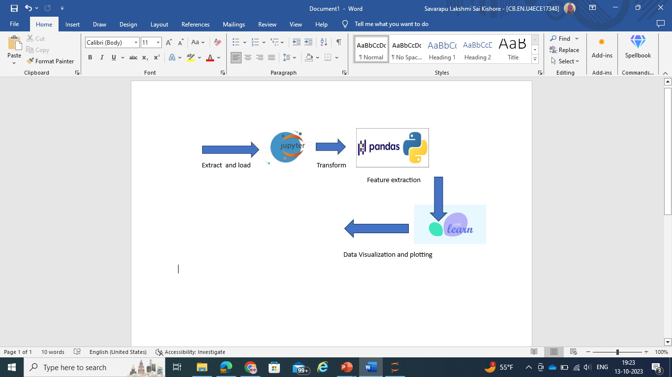

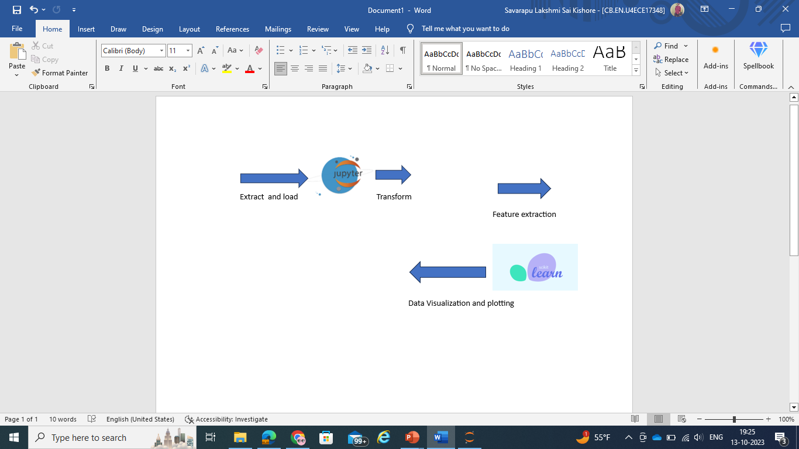

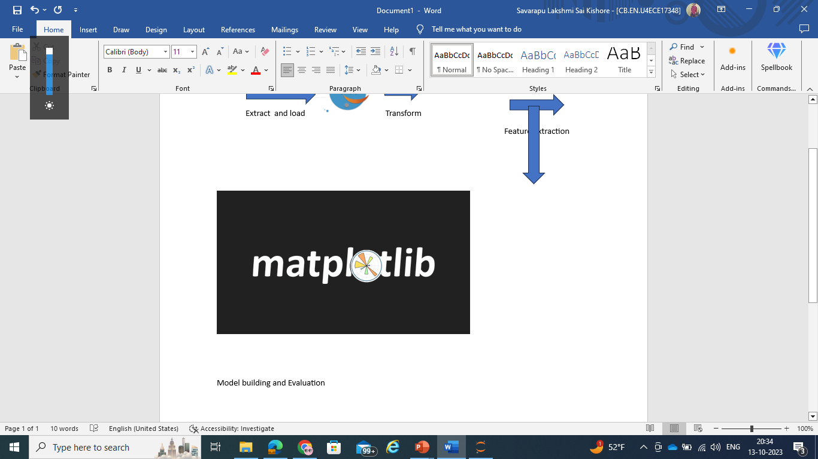
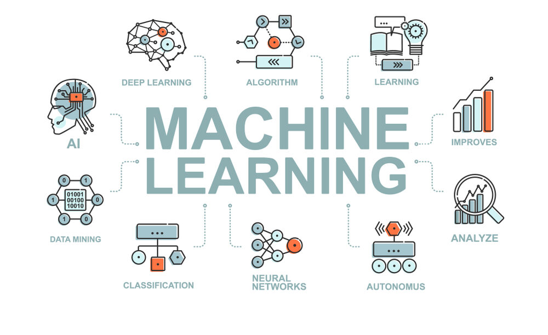
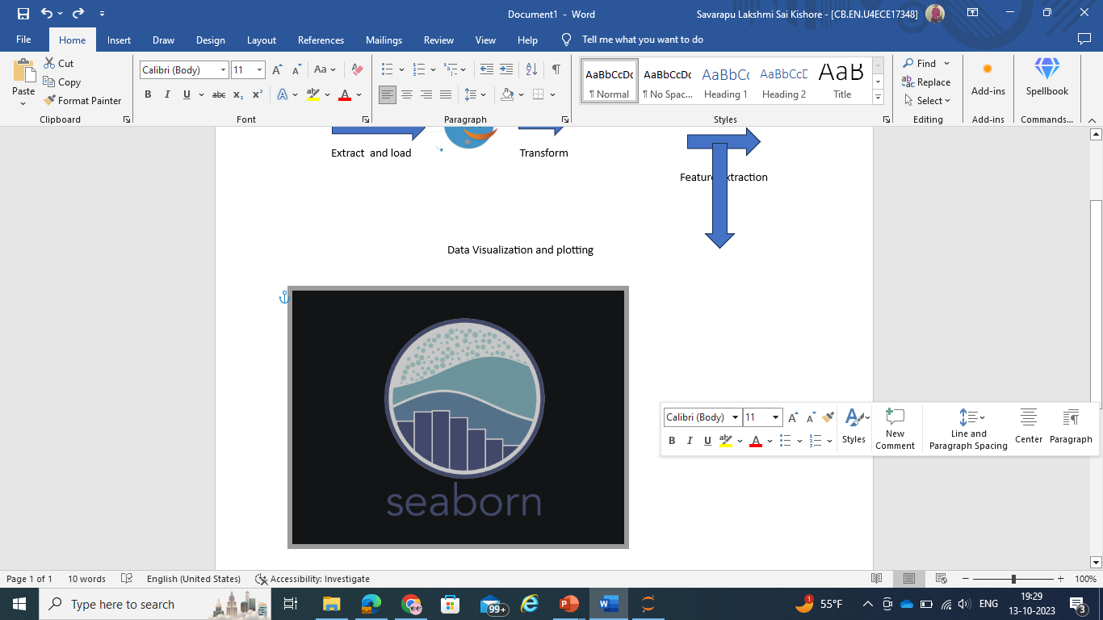
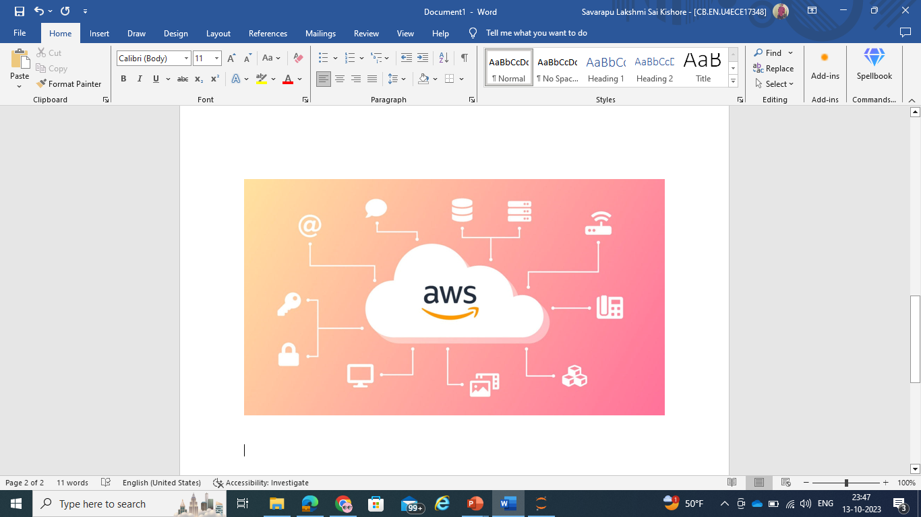
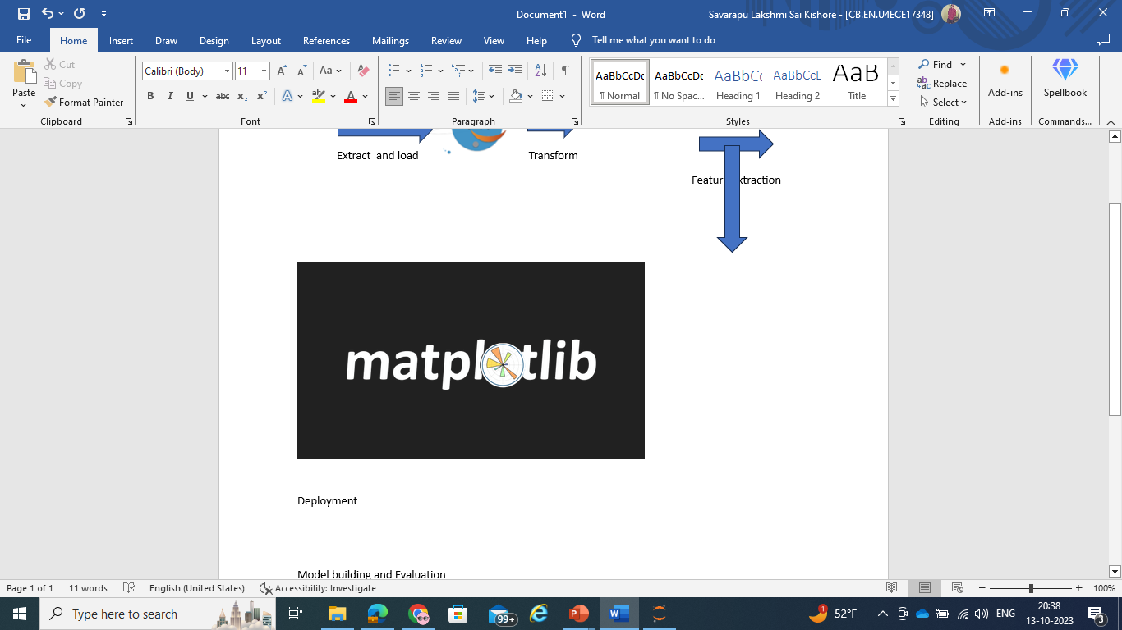
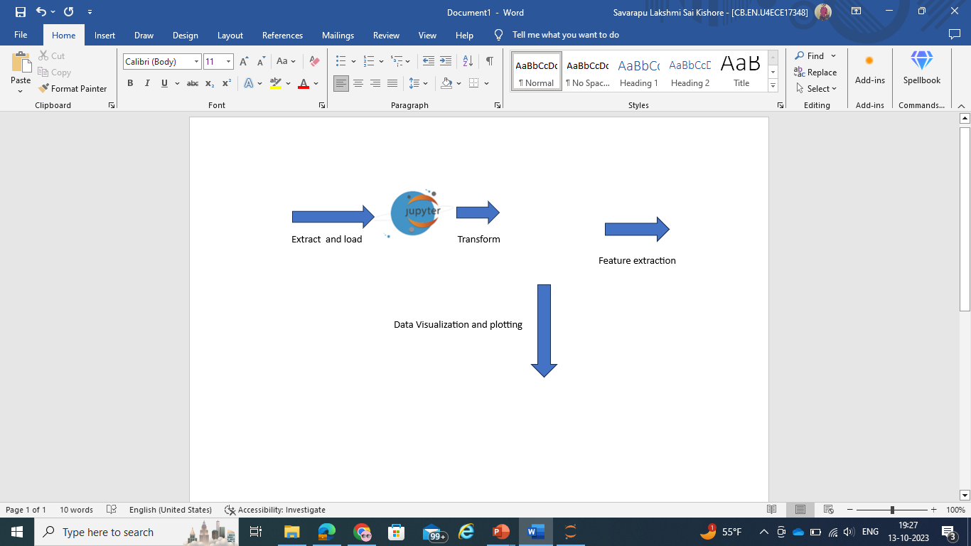

GRAPHICAL VIEW OF THE Proposed MODEL

Slide 8
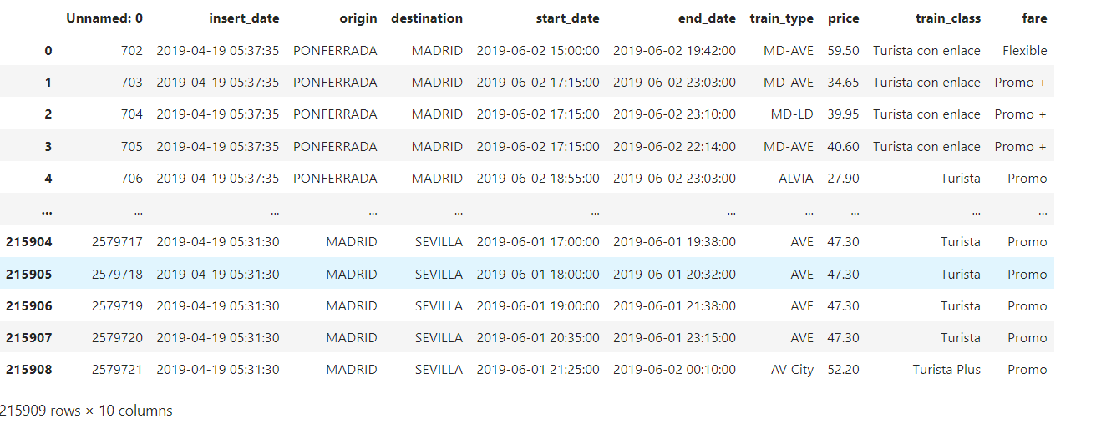
Dataset from Kaggle
https://www.kaggle.com/code/umairaslam/train-ticket-price-prediction-project/input
Volume: 215909 samples of data
Variety: Structured Data
Velocity: Data generated during the pre covid period
Veracity: Kaggle is said to be the trusted go to point of information
Value: Data can be used to estimate domestic train ticket prices in Spain

Slide 9
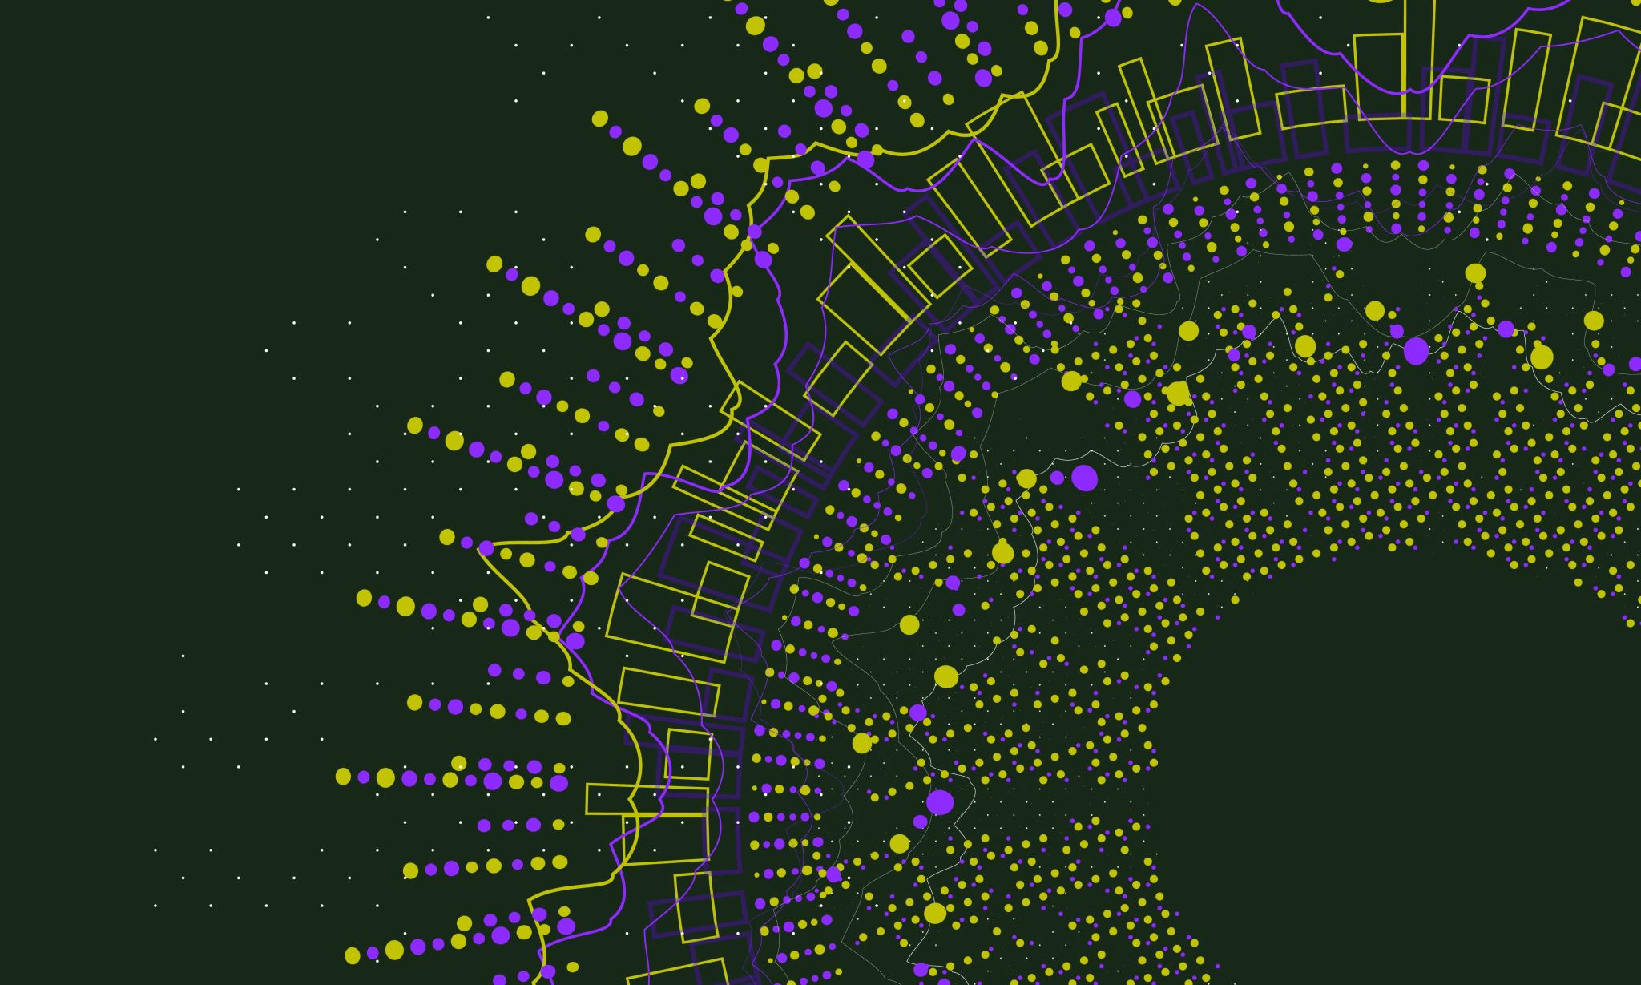
Tools to be used
Data is collected from Kaggle and stored in Github account for usage and access to the team (Data Storage).
Data is then ingested into Jupyter python notebook (Data Ingestion).
Python libraries such as numpy, matplotlib, sklearn, pandas, seaborn etc are imported for pre-processing and feature extraction on the data (Data Processing).
Machine Learning models are built using the dataset and are evaluated.
Model and the dataset are stored in Github and AWS for accessibility to data scientists, analysts and end users (Data Consumption).
AWS is used to host the end user web application.

Slide 10

MODELS TO BE USED
Data Engineering pipeline is applied through out the process to ensure perfect execution.
5 V’s of Data is checked to ensure right set of data is collected for the problem statement.
Data Preprocessing is carried out to ensure no noise or bias or outliers are present in the data.
Feature extraction is performed to transform categorical variables and non numeric values so that the Machine Learning model can understand.
Linear Regression and Random Forest Regressor models are build using the dataset.
Models are evaluated by calculating errors and accuracy.
Models are deployed successfully.

Slide 11
references
https://youtu.be/WjLou_0YVMo?si=O_MsRoI5q4ooTXeC
https://youtu.be/46bRwRvW0PI?si=KIchjcJvDOZkfBMq
https://youtu.be/KFPX0FLhscs?si=VSFVpvoKYssh3epv

Slide 12
Thank You and Have a Safe Train!

